Slide 1
Rearranging Efficiency Equation and teach examples

Slide 2
Learning Objectives
I can mathematically rearrange the efficiency equation.
I can calculate efficiency using the formula.
Notes:
In this lesson, students will learn the definitions of both potential and kinetic energy. They will also be able to give examples of each and explain how potential energy changes into kinetic energy.

Slide 3
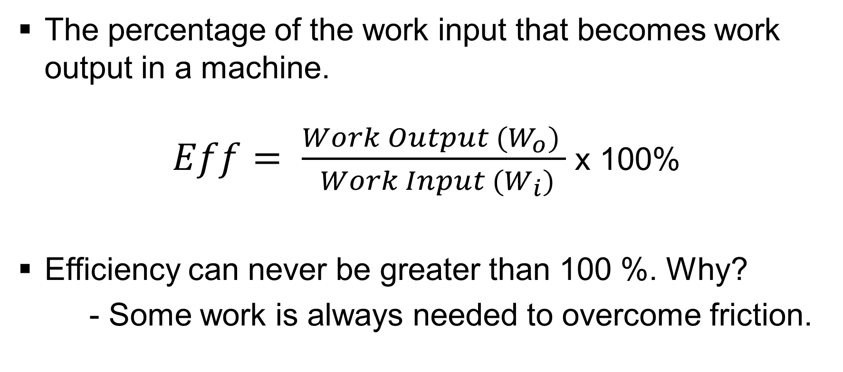
Efficiency
The percentage of the work input that becomes work output in a machine.
$Eff= \frac{{Work Output (W}_{o}) }{ {Work Input (W}_{i})}$ x 100%
Efficiency can never be greater than 100 %. Why?
- Some work is always needed to overcome friction.

Slide 4
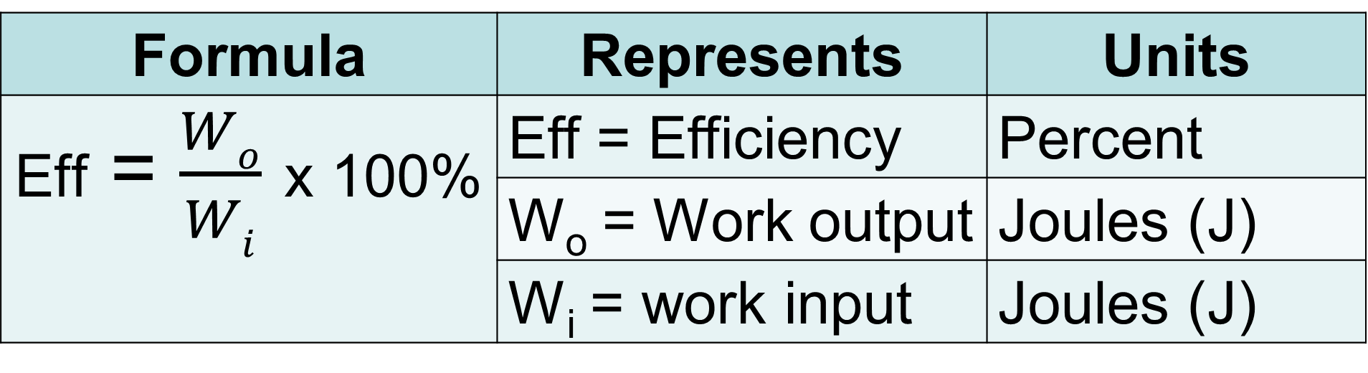
Formula Representation
Formula | Represents | Units
Eff = $\frac{Wo}{Wi}$ x 100% | Eff = Efficiency | Percent
 | W_{o} = Work output | Joules (J)
 | W_{i} = work input | Joules (J)

Slide 5
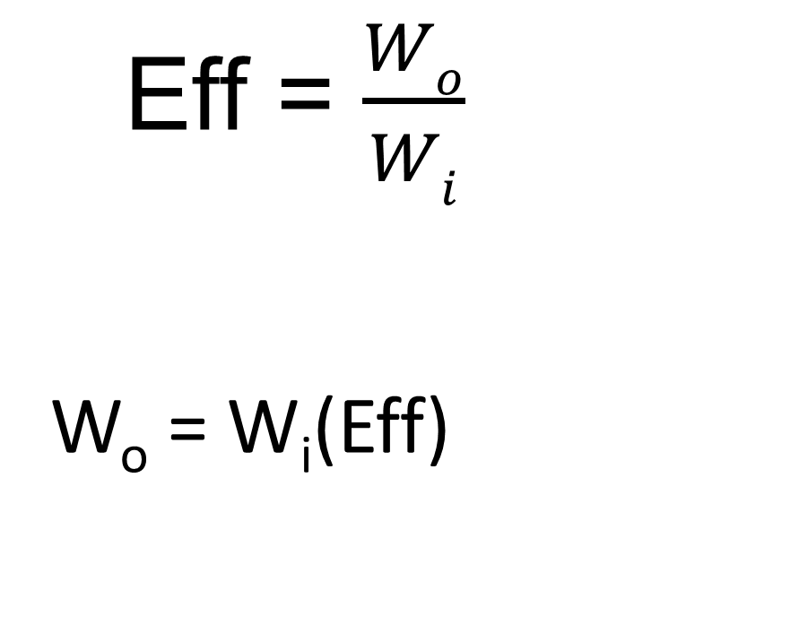
Solve for Work Output (W_{o})
(W_{i})
Step 1 – Multiply both sides by W_{i} - work input
Eff = $\frac{Wo}{Wi}$
W_{o} = W_{i}(Eff)
(W_{i})

Slide 6

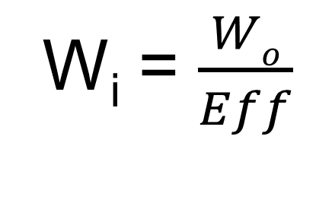

Solve for Work Input (W_{i})
(W_{i})
Step 1 – Multiply both sides by W_{i} - work input
Step 2 – Divide by Eff -efficiency on both sides.
Eff = $\frac{Wo}{Wi}$
(W_{i})
W_{i}Eff = W_{o}
__
Eff
__
Eff
W_{i} = $\frac{Wo}{Eff}$

Slide 7
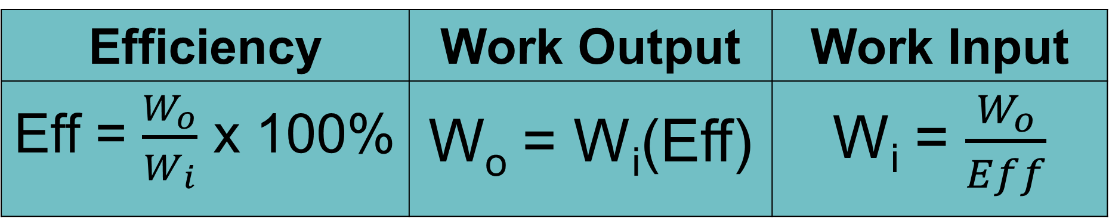
Efficiency Related Equations
Efficiency | Work Output | Work Input
Eff = $\frac{W_{o}}{W_{i}}$ x 100% | W_{o} = W_{i}(Eff) | W_{i} = $\frac{W_{o}}{Eff}$

Slide 8

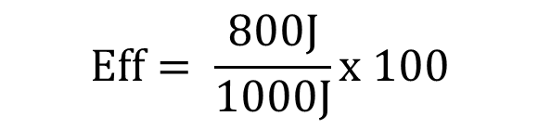

Calculation Example #1
1. You have just designed a machine that uses 1000J of work from a motor for every 800J of useful work the machine supplies. What is the efficiency of your machine?
Given/ Unknown | Work
Eff = W_{o} = W_{i} =
?
800J
$$Eff=\frac{Wo}{Wi}x 100$$
$$Eff= \frac{800J}{1000J}x 100$$
$$Eff=80\%$$
1000J

Slide 9



Calculation Example #2
2. If a machine has a efficiency of 40%, and you do 1000J of work on the machine, what will be the work output of the machine?
1st take efficiency percent and put into a decimal.
Given/ Unknown | Work
Eff = W_{o} = W_{i} =
40%
or .4
To convert percent to decimal move the decimal 2 places to the left.
?
So 40% will be .4
1000J
$$\text{Wo}\text{ = }\text{Eff} \text{x} \text{Wi}$$
$$\text{Wo}\text{ = (.4)(1000}\text{J}\text{)}$$
$$\text{Wo}\text{ = 400}\text{J}$$

Slide 10

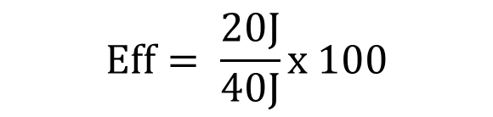

Calculation Example #3
3. Using a lever, a person applies 40 newtons of force and moves the lever 1 meter. This moves a 200 newton boulder at the other end by .1 meters. What is the efficiency of the lever?
1st calculate the work output and work input.
Given/ Unknown | Work
Eff = F_{r} = D_{r} = F_{e} = D_{e} =
?
Wo = Fr x Dr
Wo = (200N)(.1m)
Wo = 20J
200N
Wi = Fe x De
Wi = (40N)(1m)
Wi = 40J
.1m
$$Eff=\frac{Wo}{Wi}x 100$$
$$Eff= \frac{20J}{40J}x 100$$
40N
$$Eff=50\%$$
1m

